Slide 1
Chatbots,
Gen Z, and the Cleveland Clinic
A Consumer Behavior Case Study
DD-602-02
Online Consumer Behavior
Chelsie Vasco, Effie Loupakis, and
Olivia Ujlaki

Slide 2
Introduction
01
03
Subculture
Campaign
02
04
Research
Conclusion
Overview of Gen Z & Marketing Opportunity
Our findings and digital marketing campaign plans
Breakdown of primary and secondary data points collected
What we learned and final thoughts

Slide 3
–Planoly
“Gen Z is changing the social landscape. Marketers better take note or they won’t keep up”
-SOMEONE FAMOUS

Slide 4
Generation Z: Secondary Research
Digital Natives
Mental Health
The only generation of complete “digital natives”
46% say they are anxious most of the time and 48% say they are more stressed since the start of the coronavirus pandemic
Socialization
Healthcare Services
Have difficulty disconnecting from technology. Are less emotionally resilient and more insecure than previous generations (Eckleberry-Hunt, Lick, and Hunt para. 7)
70% of respondents are more likely to choose a healthcare provider that sends email and text reminders, and 53% more likely to choose a provider that offers remote or telemonitoring devices.

Slide 5
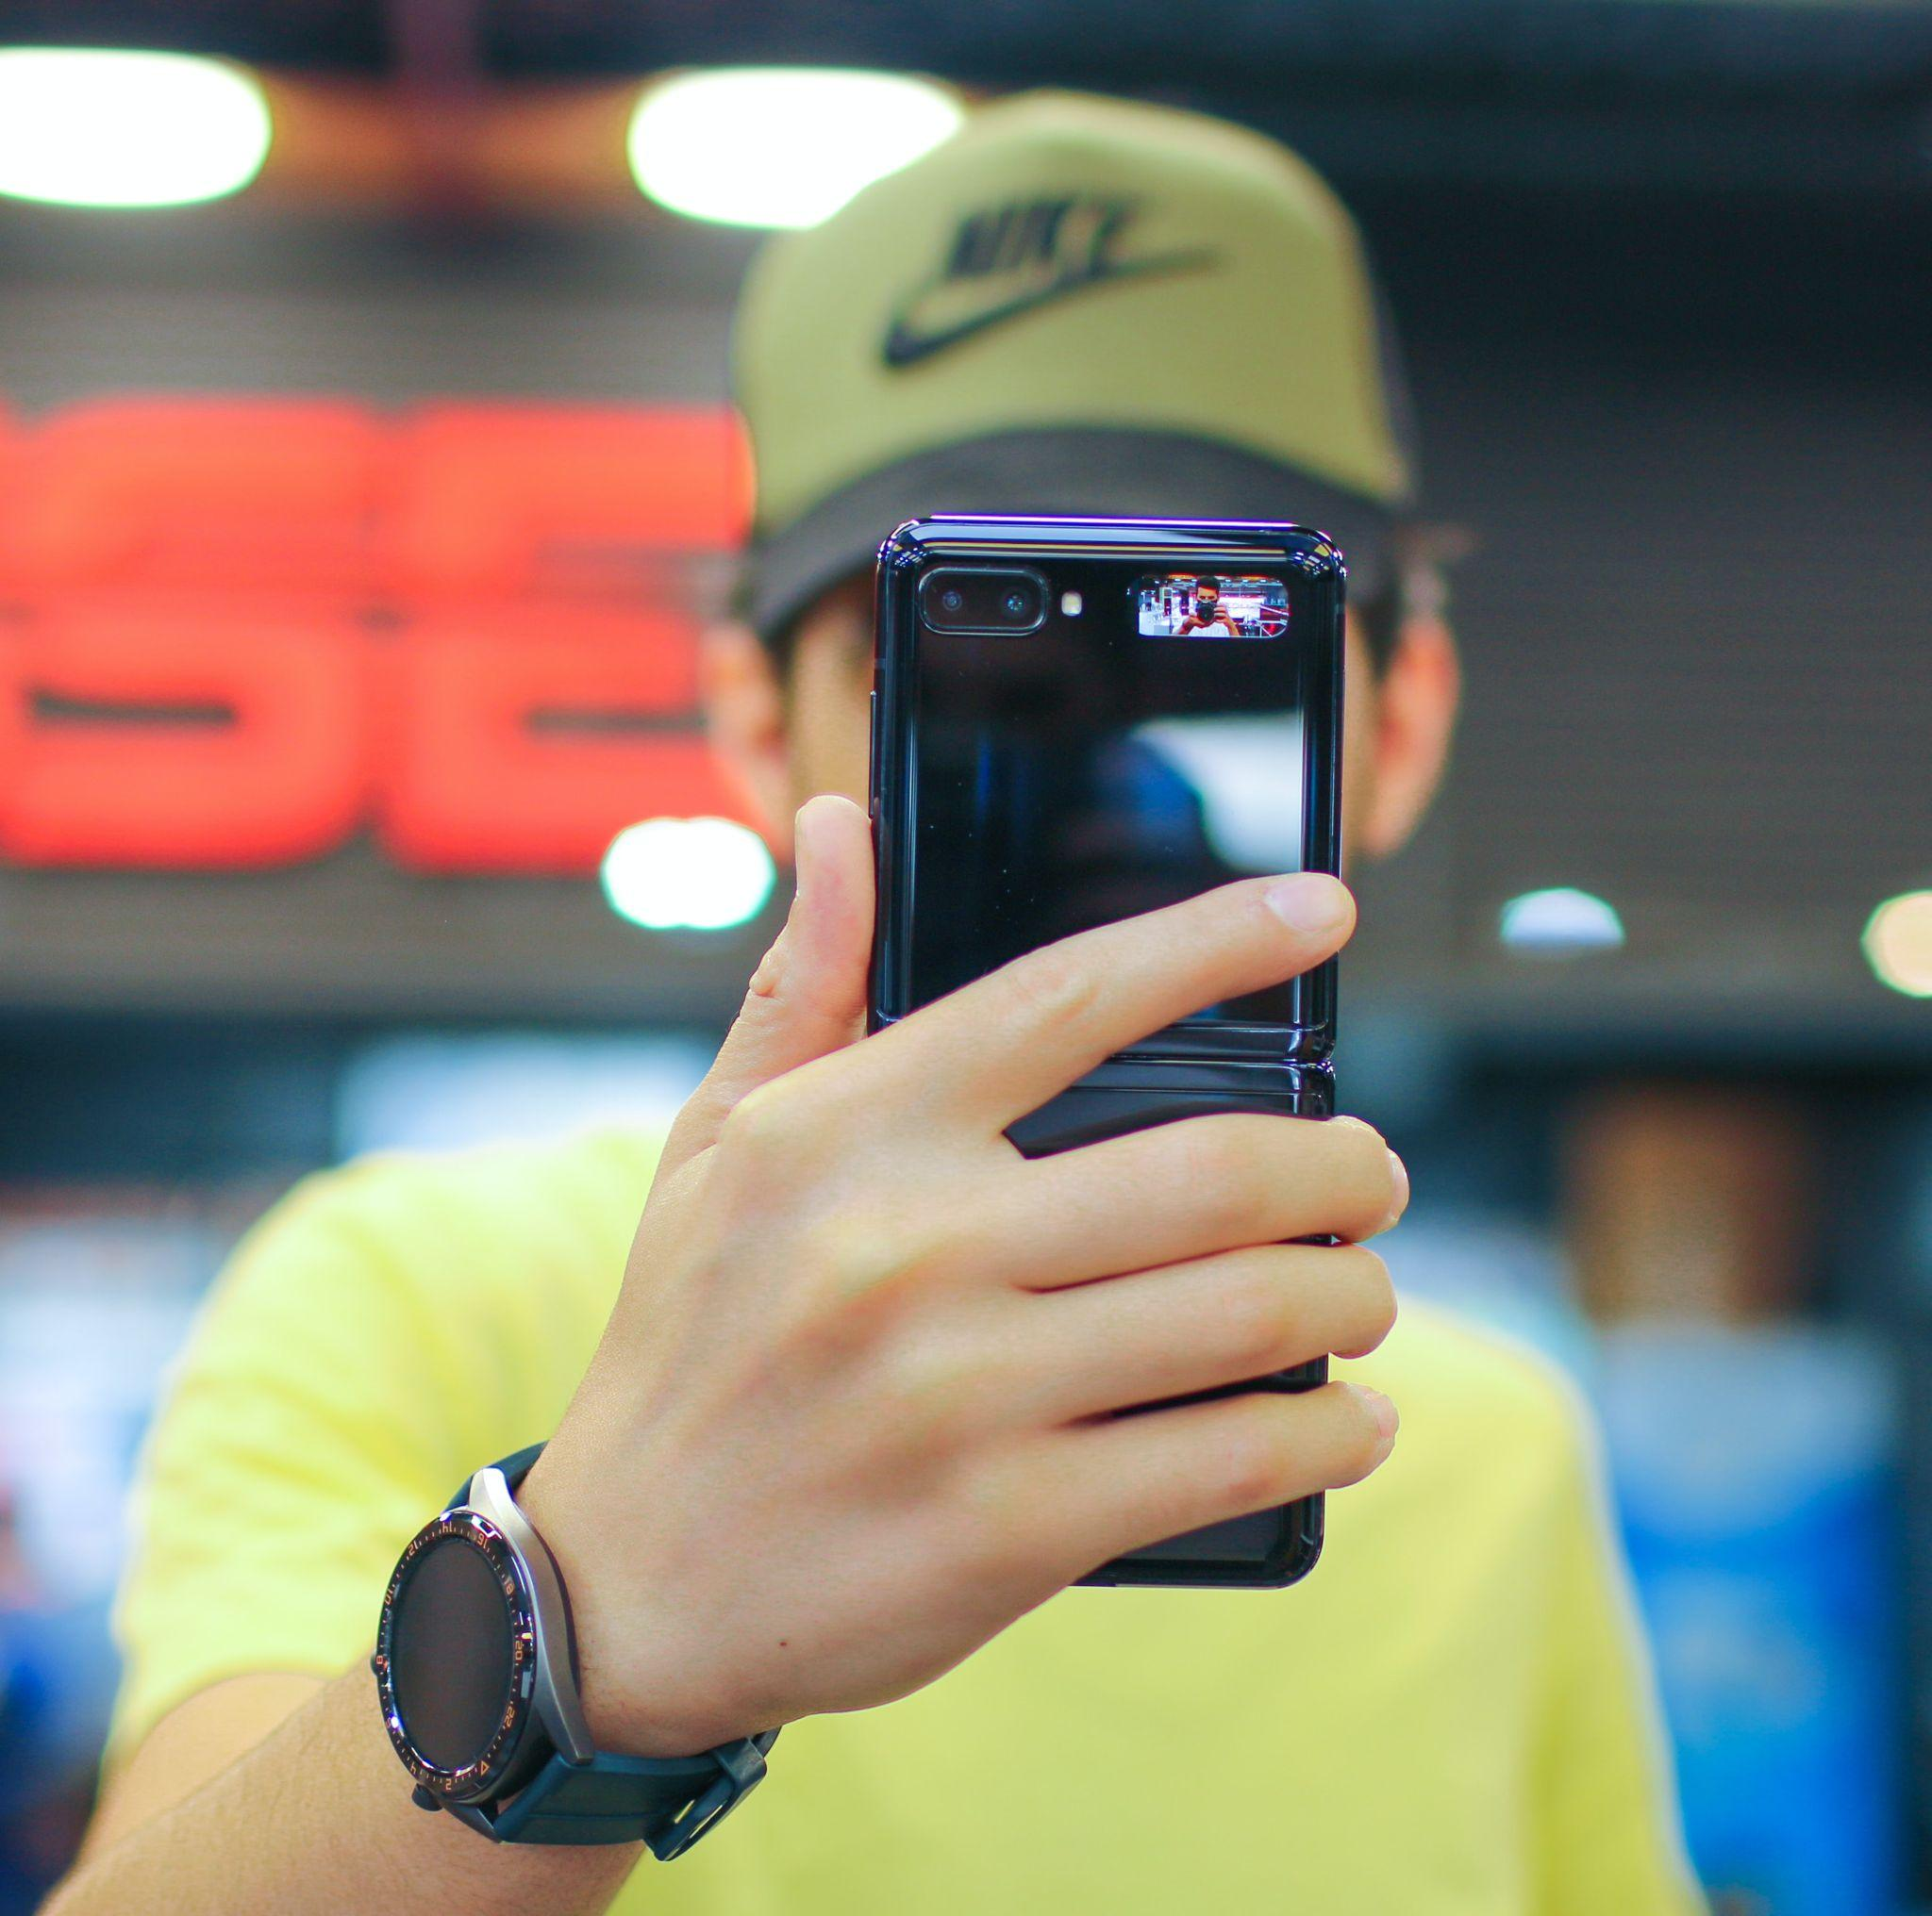
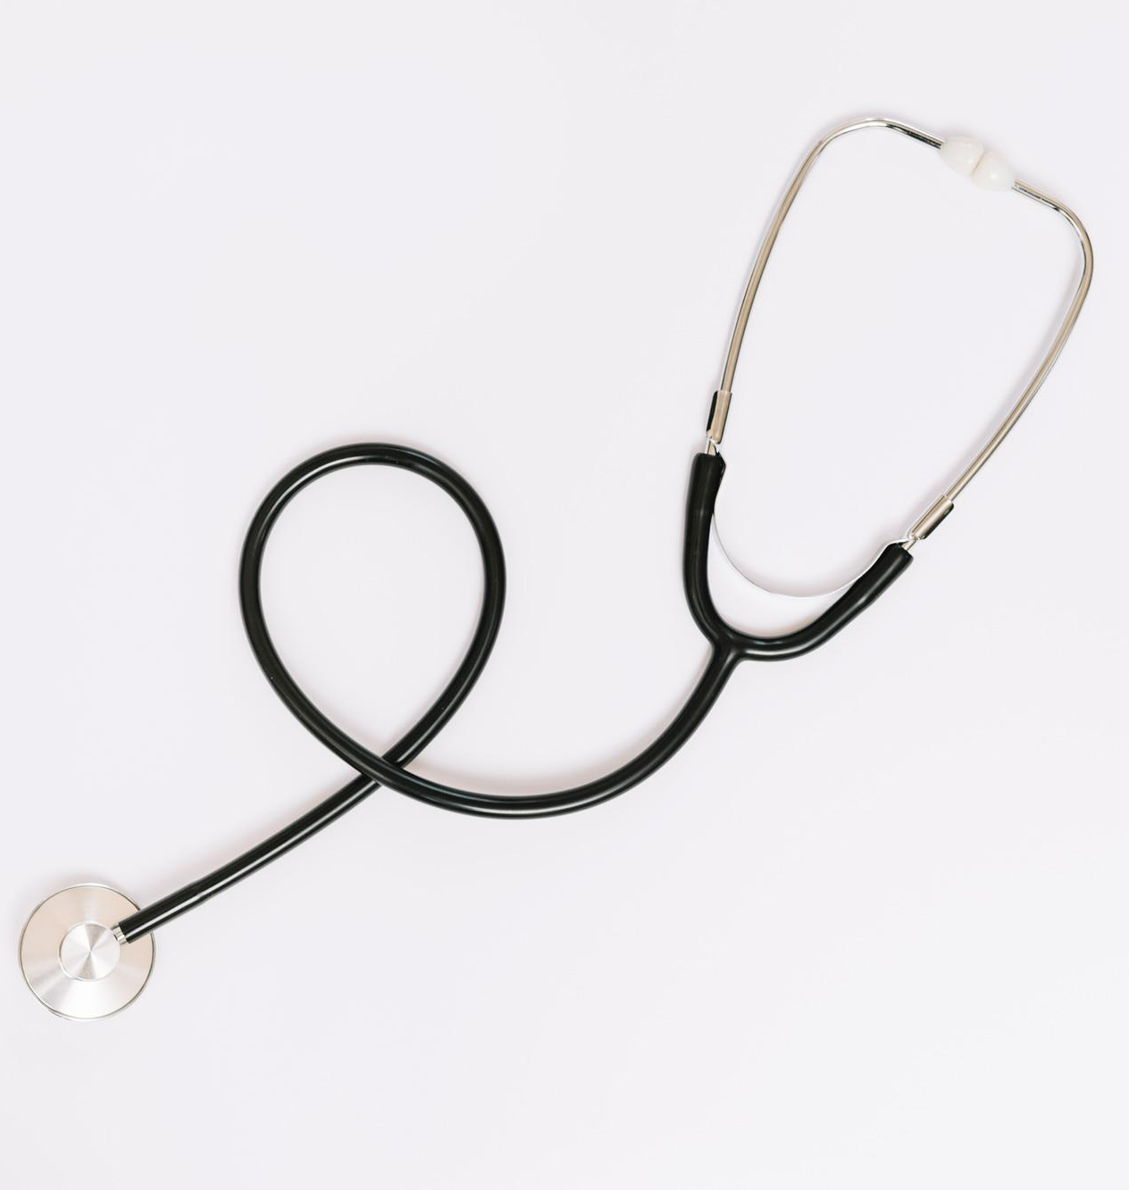
75%
81%
46%
Avoid Phone Calls
Get Anxiety over Making Phone Calls
Are Anxious Most of the Time

Slide 6
Generation Z: Primary Research
The Group
Mental Health
6 Gen Z’ers: 5 females and 1 male, ages 17-19, for half hour interviews
All interviewees stated it was “very important,” to care for their mental health, but only one was actually seeking ongoing care
Technology
Healthcare Services
All interviewees noted a heavy use of their mobile device for personal and academic purposes. Hesitant towards the adoption of chatbots in healthcare due to privacy/data concerns
All interviewees appreciate the flexibility of texting and emailing doctors as opposed to arranging in-person visits especially for minor health concerns

Slide 7
– Interviewee
“I wouldn't mind talking to a chat bot [but], I prefer an actual person to talk over my problems with so phone call and text messaging would be nice.”
-SOMEONE FAMOUS

Slide 8
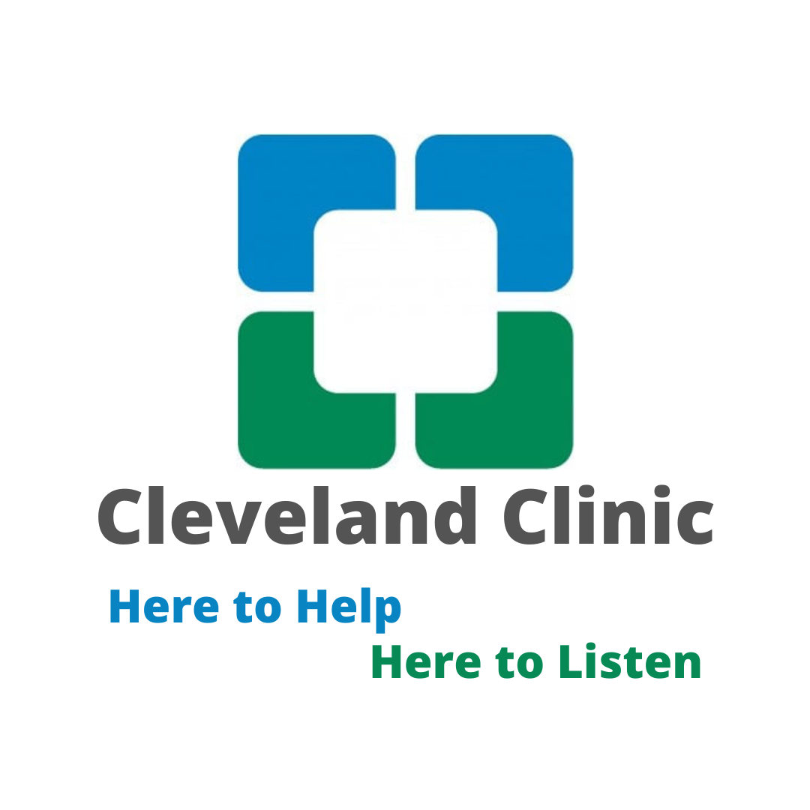
Our Message
Builds off of a TV ad from March 2021 called “Here for you, everything you need”
Seeks out members of Gen Z on on the digital platforms they use most

Slide 9
Our Platforms
TikTok
Youtube
Instagram
Snapchat
Scroll specific and non-disruptive ads
15 second,
unskippable ads
Reels, and static post ads
National holiday filters
Our primary research identified these 4 platforms for highest use in our target demographic
All advertising will be conducted using geotagging to target those in the Cleveland area

Slide 10
Marketing Strategy
Mobile first ads that focus on mental health featuring images of patients that look like members of Gen Z

Slide 11
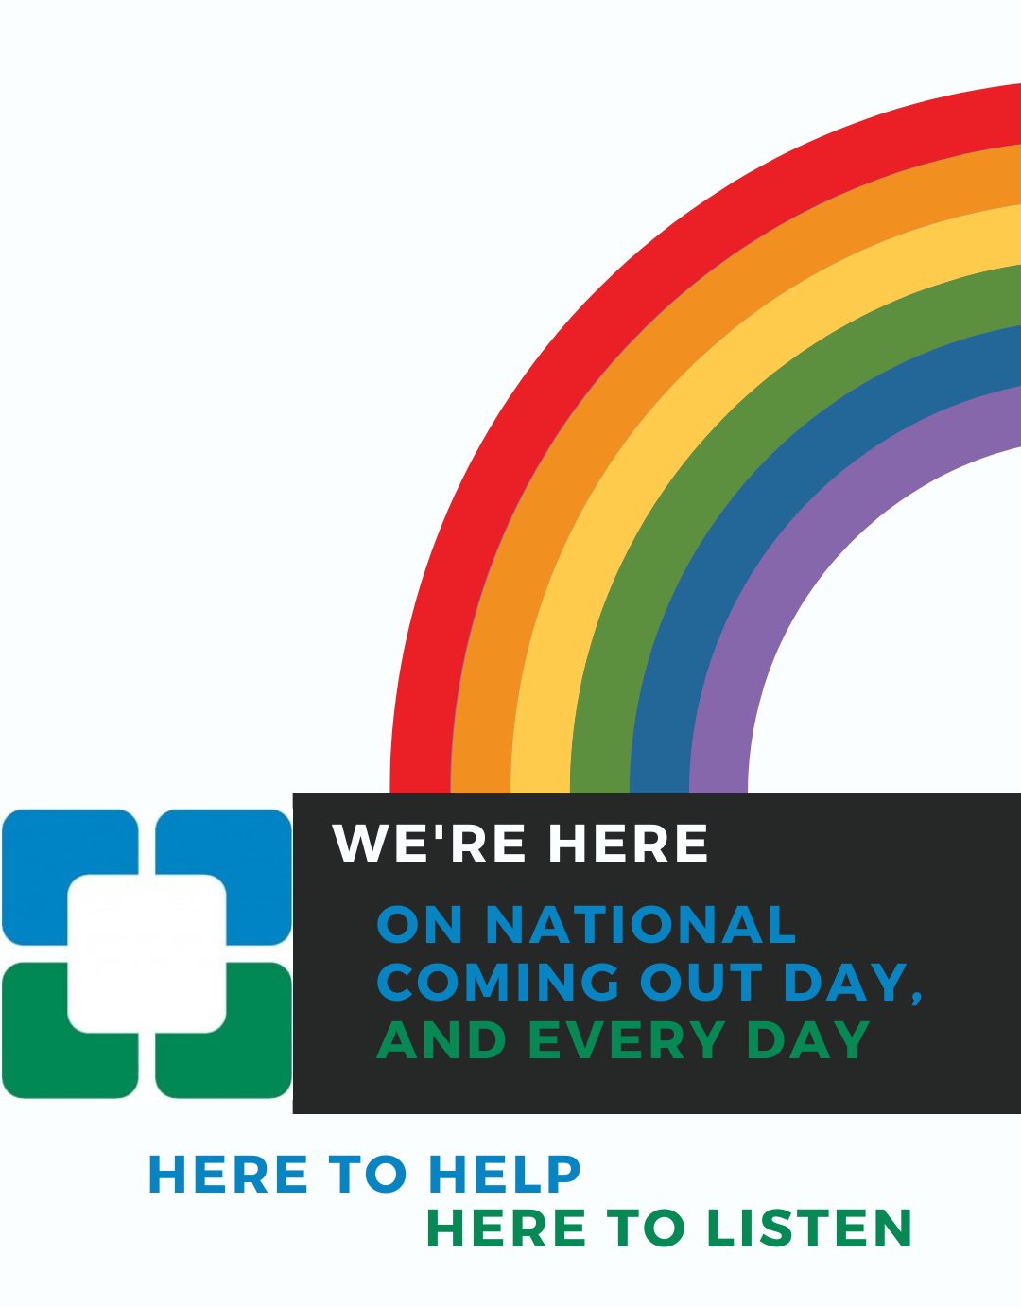
Snapchat Filters
National Coming Out Day
October 11th
Transgender Awareness Week
November 13-19
Mental Health Awareness Day
October 10th
01
02
03

Slide 12
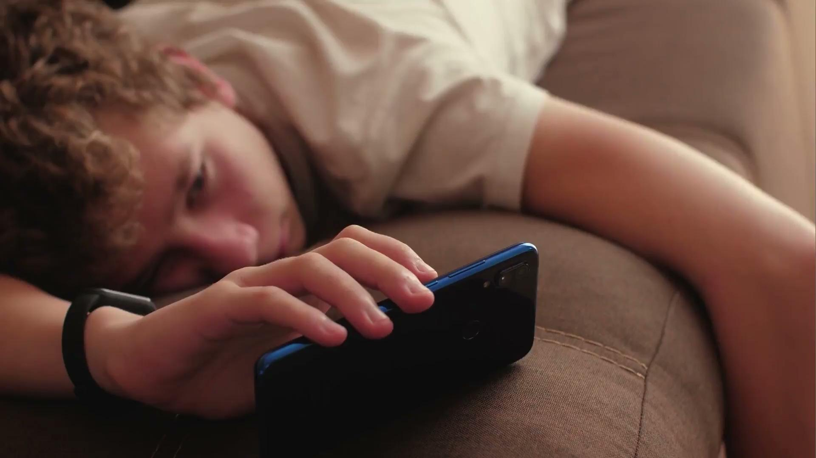
YouTube
Market research shows the ideal length for a Youtube ad is between 15-20 seconds (Idea Rocket)
Our ad focuses on the GenZ user, staying clear of hospital and clinical imagery and centering around their lifestyle

Slide 13
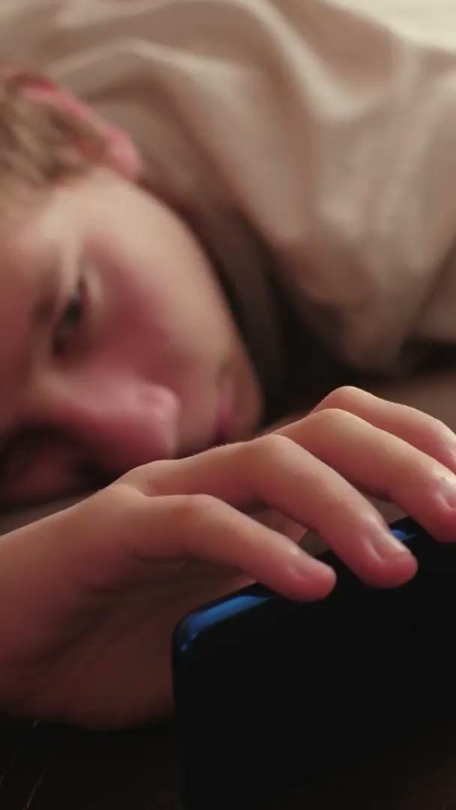
Tiktok and Instagram
This is a modified version of the YouTube ad optimized for vertical mobile displays on TikTok and Instagram Reels

Slide 14
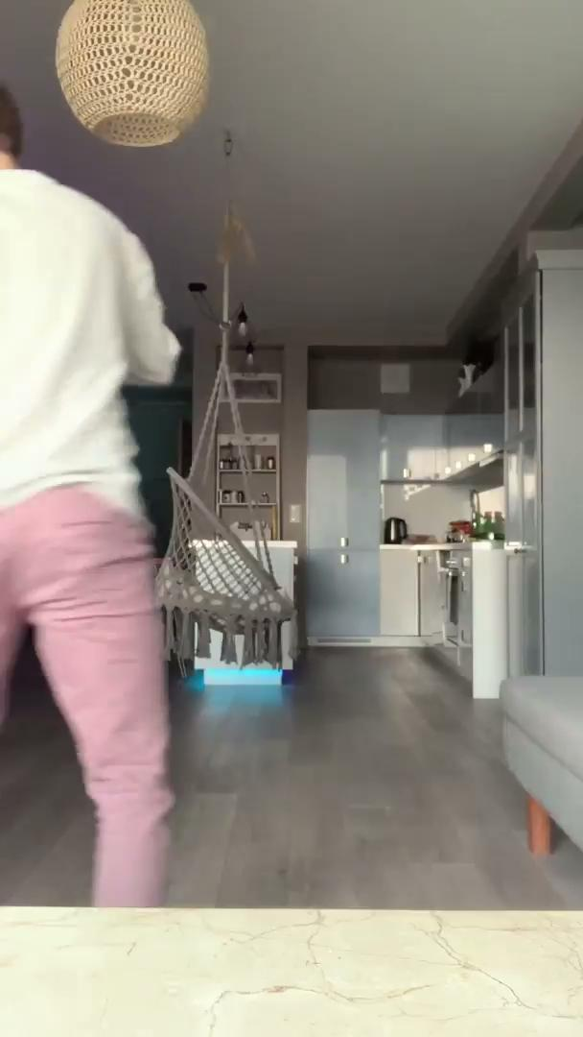
Tiktok and Instagram
Reels
Created to not disrupt scroll flow and ideally used with influencers local to Cleveland and relevant to Gen Z

Slide 15
Conclusion
A personalized healthcare chatbot service would attract more members of Generation Z to Cleveland Clinic.
Cleveland Clinic will need to create awareness of its chatbot services to generate adoption.
AI-powered mobile-friendly chatbots, would be a welcome avenue for Generation Z to engage with for mental health services.

